Slide 1


LOTSO’s Final sprint review
Team 2 Members:
Jocelyn Chia – S10221061 ​
Geraldine Koh – S10242807 ​
Andrew Ng – S10243027 ​
Quek Xin Quan – S10243101 ​
Neron Phang - S10241905

Slide 2

Agenda
01
Project Overview
04
Last Sprint Retrospective
High-level summary of the project's objectives, scope, and stakeholders
Review of last sprint's work, outcomes, and improvement opportunities.
02
Sprints Overview
05
Burn Down/Up Chart
Charts to record project progress overtime
03
Product/Sprint Backlog
06
Our team
Prioritized tasks and features list for upcoming development sprint cycle.
Meet the team of Lotso!!

Slide 3
Useful Analytics & Insights
Real-time Dashboarding
Employee Performance
Supplier Performance
Sales Analysis
Customer Analysis
Product Overview

Slide 4

Project Overview
Project Overview: Modernize NWT's data and reporting solutions
Objective: Move from on-premise MySQL to cloud-based Snowflake
Goals:
Improve scalability
Reduce operational system load
Enhance reporting speed
Increase data security
Methodology: Agile and Scrum for project management
Tools: Use dbt and Snowflake for DataOps tasks
Outcome: Create dashboard visualizations for insightful data analytics

Slide 5






Sprints Overview
SPRINT 01
Start
Identify reporting needs and creating tables in Snowflake
SPRINT 02
SPRINT 03
Data Loading
Linkage to PowerBI
SPRINT 05
SPRINT 04
Finalizing release product
Handle updated order information and create dashboards

Slide 6
Sprint 1 - Identifying Reporting Needs
Purpose of this sprint?
What was done in this sprint?
Establish clear project goals and detailed reporting needs
Initiating the technical setup of the Snowflake database
Created Snowflake Account:
Set members user credential
Begin designing Snowflake database schema
Start building essential Snowflake tables for data storage and future reporting
Why?
It ensures the development aligns with NWT expectations and project goals from the start, setting the stage for efficient, targeted progress in subsequent sprints.

Slide 7
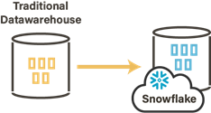
Sprint 2 - Data Migration
Purpose of this Sprint?
What was done in this sprint?
Load in our data into a cloud based data warehouse (Snowflake)
ELT Process:
Extracting the data from Github
Loading the data into tables we previously created in Snowflake
Transforming the data using SnowSQL & Dbt, performed data cleaning & preprocessing
Why?
By moving to a Snowflake, we will be addressing NWT’s pain points with their current OLTP System
With Snowflake, we can set up a OLAP System in order to meet NWT’s meets

Slide 8
Sprint 3 - Linking to PowerBi
Despite being red, is a cold place. It’s full of iron oxide dust
Purpose of Sprint:
What was done in this sprint?
Integrate the Snowflake data warehouse with PowerBi for dynamic data visualisation
Integrated Snowflake data warehouse with Power BI.
Focused on leveraging Power BI's advanced analytical tools.
Ensured secure and reliable connection setup between Power BI and Snowflake.
Shifted focus to designing data models within Power BI.
Established relationships between different datasets in Power BI.
Created calculated columns or measures as needed for analysis.
Laid the groundwork for the reporting and analysis framework in Power BI.
Why:
This integration is key for direct data interaction and utilizing Power BI's analytical capabilities.
Effective data modeling is essential as it forms the basis of the reporting and analysis framework in Power BI, leading to intuitive and informative dashboards.

Slide 9
Sprint 4 - Creation of Dashboards
Purpose of Sprint:
What was done in this sprint?
Streamlining data updates in the Snowflake data warehouse
Developing sophisticated dashboards and reports in Power BI.
Continued building on the established infrastructure.
Implemented Incremental Data Loading
Developed dashboards and reports
Aimed to unlock deeper insights from data tailored to end-user needs.
Incorporated feedback from previous sprints for user-friendly dashboards aligned with stakeholder requirements.
Why:
Efficiently update the warehouse with new or modified order information, reducing data transfer volumes and optimizing the overall data processing workflow.
provide deeper insights tailored to the specific needs of end-users and stakeholders.

Slide 10
Sprint 5 - Finalizing
Purpose of this sprint?
What was done in this sprint?
Deploy the final product into production, integrating all components like data pipelines, database structures, and dashboards developed in earlier sprints.
Final checks, regression, performance, and user acceptance testing
Ensure everything functions correctly and meets the initial requirements, marking a critical phase in delivering a complete, operational solution.
Why?
Essential for delivering a functional and reliable product, allowing the team to address any final issues and ensure the system's readiness for operational use.

Slide 11
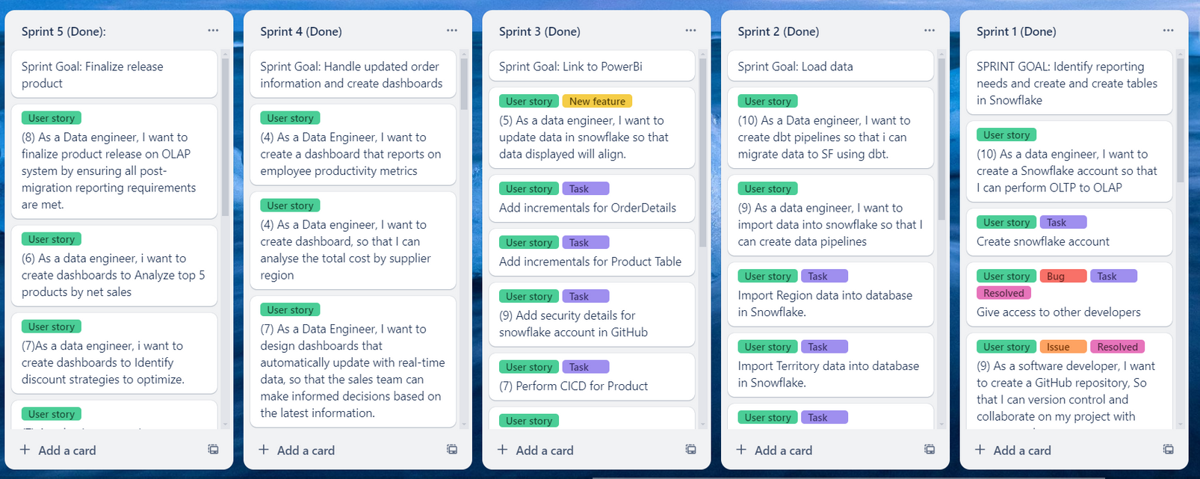

Product/SprintBacklog
Trello board

Slide 12
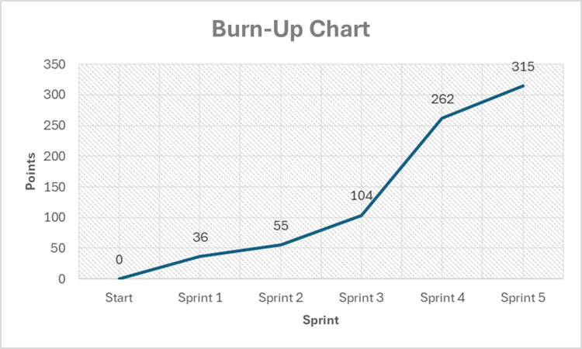
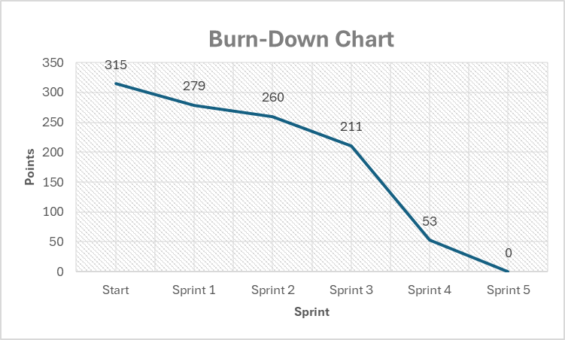
Burn Down/Up Chart
Total amount of work done against the total amount of work identified over time.
Amount of work remaining to be done in the project over time.

Slide 13

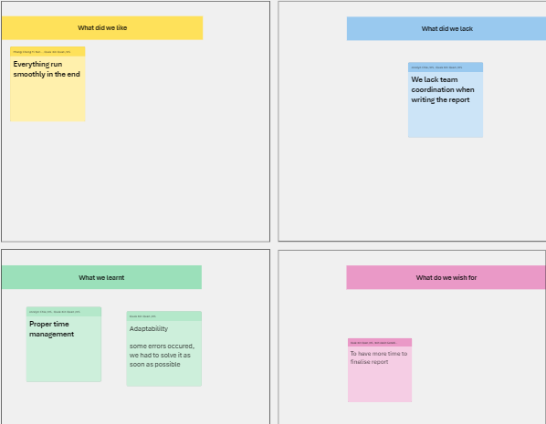

Last Sprint Retrospective

Slide 14


Meet the Team of Lotso!
neron
geraldine
andrew
xin quan
Jocelyn

Slide 15

Individual Presentation
Showcase dashboard and useful insights for NWT

Slide 16



Links & Credentials
Scrum Board
Snowflake User Credential
Trello: https://trello.com/b/Czr4gKpb/assignment-2-team-lotso
Geraldine
Username: Geraldine
Password: Geraldine1234
Jocelyn
Username: Jocelyn
Password : Jocelyn123
Xinquan
Username: Xinquan
Password:Xinquan123
Andrew
Username: Andrew
Password: Andrew1234
Neron
Username: Neron
Password: Neron123
GitHub
GitHub:
https://github.com/Quek-Xin-Quan/ADO-Assignment-2

Slide 17
Xinquan | As a Data engineer, I want to create dashboard, so that I can analyse the total cost by supplier region
Xinquan | As a Data engineer, I want to create dashboard, so that I can analyse the total cost by supplier region
Xinquan | As a Data engineer, I want to create dashboards, so that I can analyse total revenue by supplier
Xinquan | As a Data engineer, I want to create dashboards, so that I can analyse total number of suppliers
Xinquan | As a Data engineer, I want to create dashboards, so that I can analyse total cost for suppliers

Slide 18
Andrew | As a Data engineer, I want to create dashboards, so that I can identify the top customers based on orders.
Andrew | As a Data engineer, I want to create dashboards, so that I can identify the regions whereby most of my customers are located.
Andrew | As a Data engineer, I want to create dashboards, so that I can easily view the demographics of my top customers.
Andrew | As a Data engineer, I want to create dashboards, so that I can track the order status performance for my customers.
Andrew | As a Data engineer, I want to create dashboards, so that I can analyse the geographical spread of customers

Slide 19
Neron | As a Data Engineer, I want to view the trend of top products over the years so that I can analyse their performance and make informed business decisions
Neron | As a Data Engineer, I want to view the top 5 products for each product category so that i can focus on key products and optimize marketing strategies.
Neron | As a Data Engineer I want to view the top 5 products sold overall so that I can tailor marketing strategies accordingly.
Neron | As a data engineer, I want to view the total number of products in our catalogue so that I can have a quick overview of our product offerings and track catalogue growth.

Slide 20
Geraldine | As a Data engineer, I want to create dashboards, so that I can analyse the net sales (revenue - discount) amount and gross revenue of the organization.
Geraldine | As a Data engineer, I want to create dashboards, so that I can analyse the top 5 customers by net sales amount
Geraldine | As a Data engineer, I want to create dashboards, so that I can analyse geographical spread of customers and target countries with high net sales.
Geraldine | As a Data engineer, I want to create dashboards, so that I can analyse top/bottom 5 products by net sales
Geraldine | As a Data engineer, I want to create dashboards, so that I can analyse year on year growth by net sales
Geraldine | As a Data engineer, I want to create dashboards, so that I can analyse the discontinued products by net sales

Slide 21
Jocelyn | ·As a Data engineer, I want to create dashboards, so that I can analyze the employee performance
Jocelyn | ·As a Data engineer, I want to create dashboards, so that I can analyze the employee relevant sales by country
Jocelyn | ·As a Data engineer, I want to create dashboards, so that I can analyze the employee’s position and its relation to its sales revenue
Jocelyn | ·As a Data engineer, I want to create dashboards, so that I can analyze the average deal size relevant to the employee
Jocelyn | ·As a Data engineer, I want to create dashboards, so that I can analyze the sales revenue relevant to the employee across the time frame

Slide 22
The End
Thank you for listening!!

